Slide 1

Exchange Rate Application
Final Project by Nils Berzins

Slide 2
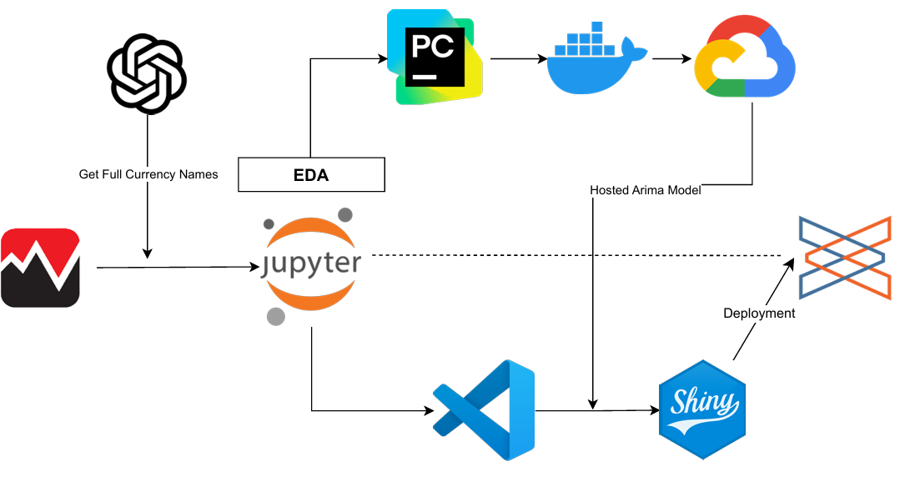
Full Project Workflow

Slide 3
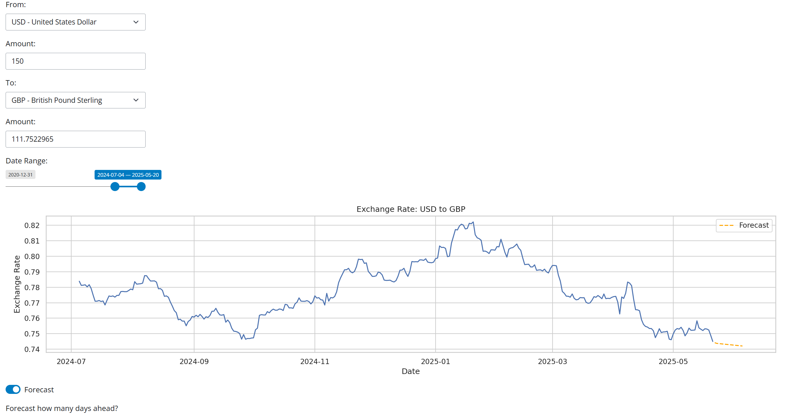
Dashboard App and Functionality
Choose from all traded world currencies
Specify “From” currency amount (default 1)
Turning on “Forecast” switch runs an ARIMA model and forecasts between 7-30 days.
Find a date range from which to graph/model
15 day forecast visible here
*Fully Reactive*

Slide 4
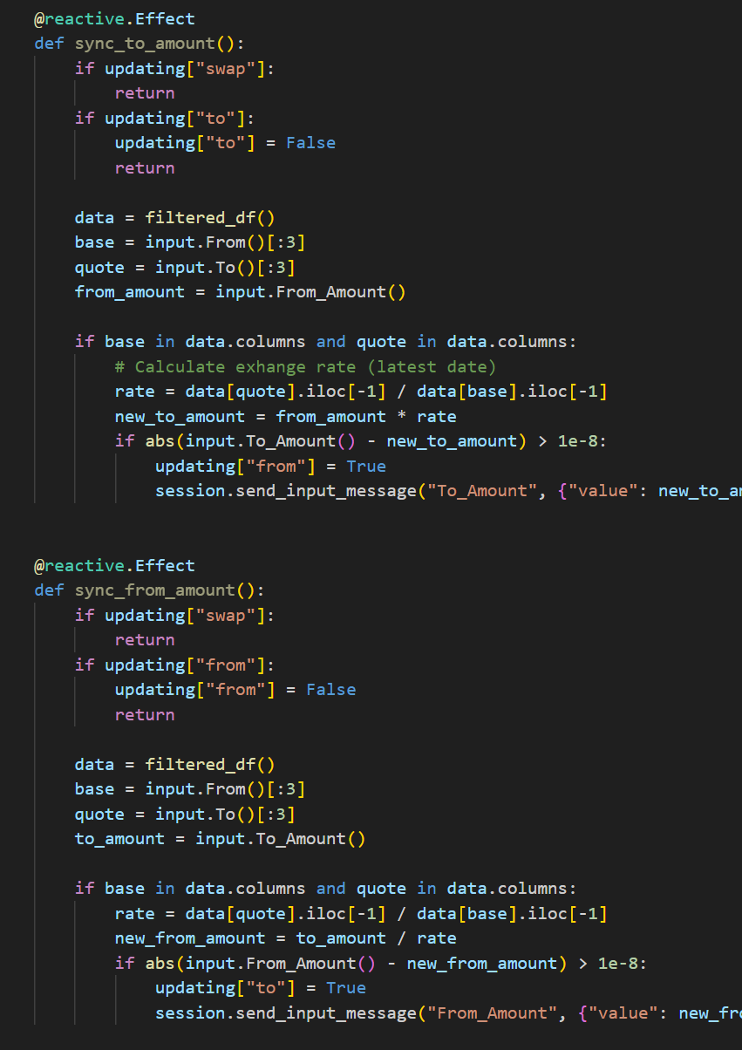
Dashboard App and Functionality – Deep Dive
Full reactivity of user inputs
Changing any of “Base”/ “Quote” country codes, date range, and/or forecasting
Cautious not to overwhelm server with user inputs → infinite loop/flip flopping values
Time.sleep(.2)
Re-entrancy Guards
Catching calculation error induced by delayed display
Without these guards Base and Quote country amounts would balloon to infinity.

Slide 5
Concluding Remarks
Given project deadline focused on functional output
After quarter end, can focus on expanding functionality and making it *pretty*
Backend model integration was easier than I thought
Initial hesitations and concerns working with Flask
In future iterations of similar projects, would need to cache output of more complex algorithms
LSTM w/ multiple epochs begins to require multiple hours of training time
VS Code w/ Copilot Integration
Extremely convenient but distracting
No longer felt like coding

